Slide 1


CATALYST
PANORMA
A Culmination of multitude of perspective
Learn more

Slide 2
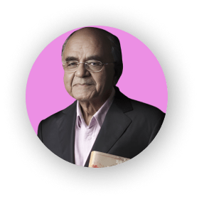
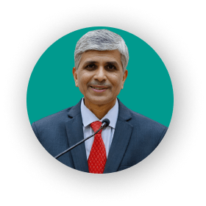

STUPENDOUS INTERVIEWS
Intriguing conversations with some of the most brilliant minds
GURUCHARAN DAS
VIVEK SAWANT
KARTHI SUBBARAMAN
Author and Ex-CEO of Procter & Gamble India
chief mentor of MKCL
Design leadership at Microsoft

Slide 3
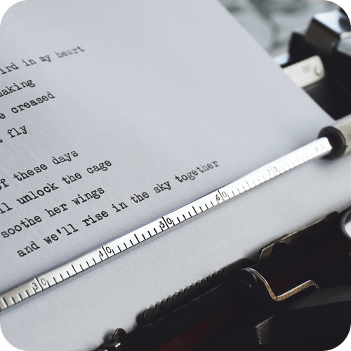

Poetic Bliss
Worldly Articles
A vibrant play of words, rhymes, rhythm put up
by our poets.
These articles make us wonder and ponder upon
thought provoking topics.

Slide 4


Appealing Graphics
Panoramic Pictures
Witness breathtaking artwork that showcases the
unparalleled talent of our
college community
Moments captured by our students through
photography are really stunning, captivating
and tell powerful stories

Slide 5



Spearhead Spotlight
Celebrating the Annual Fest, councils, and clubs that make
our college a dynamic and vibrant place.
Annual Fests
The Council
Club-intro
glimpses of our very
own college
fiestas
Implementing the functional,
managerial aspects of our student activities
Students societies cherishing
the passion, abilities and skills
of our students.

Slide 6



Our Advisors
About Catalyst
Meet the Team
insights from the people who always had our backs, Dr.A.S.Bhalchandra and Dr.Chitra Gaikwad
Patrimony
of our magazine
Know the squad that worked tirelessly to bring this edition to you

Slide 7








PANAROMA
Interview
Expressions
Overview
Gurucharan Das
Article
Annual Fest
Vivek Sawant
Poems
Clubs-intro
Karthi Subbaraman
Sketches
Council
Photographs
About Catalyst
Meet the team
Subscribe to our
Newsletter
Email
I’m Interested
catalyst@geca.ac.in
Social
c
Made With
By TEAM CATALYST
Back to top
2023 Catalyst
Made by - Shriram Vaidya

